Slide 1
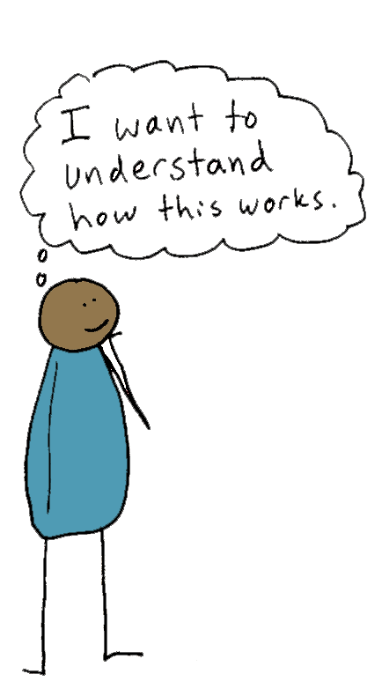
Operating Agreement
for Cooperative LLC
This Agreement has color and cartoons to make it easy to read. It is a legally binding document.
IMPORTANT: This is a very simple agreement and it won’t meet the needs of most cooperatives. We created this to teach about the basic components of Operating Agreements.
Notes:
This an operating agreement for a cooperatively structured limited liability or “LLC.” It’s a legal document, even though it probably looks unlike any legal document you’ve seen before. In fact, it’s perfectly fine to put cartoons and color in a legal document. We are doing that because it helps people to read, understand, and remember what’s in a document. For cooperatives, this is very important, because the members/owners of a cooperative should understand the operating rules of their own business. Note: This is a very simple operating agreement. We kept it simple so that you can see the most essential parts. If you start a cooperative, you will likely want to add more detail and adapt parts of it to be specific to your cooperative’s needs. For now, we have made this as simple as possible by breaking it into 13 pages.

Slide 2
Acuerdo de Operaciones para Cooperativa LLC
Este acuerdo tiene colores y caricaturas, para hacer que sea fácil para leer. Es un documento legalmente vinculante.
IMPORTANTE:
Este es un acuerdo muy simple y no satisfará las necesidades de la mayoría de las cooperativas. Creamos esto para enseñar sobre los componentes básicos de los acuerdos de operaciones.
Además, lamentamos que la traducción al español no sea profesional. Estamos trabajando para mejorarlo.
Notes:
Este acuerdo tiene colores y caricaturas, para hacer que sea fácil para leer. Es un documento legalmente vinculante.

Slide 3
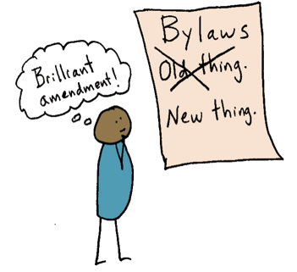
This Agreement
This Agreement has the most important rules, rights, and obligations of Members (owners) of Cooperative LLC.
(The purpose is to govern the four “matters” referenced in Corp. Code section 17701.10(a): members, managers, activities of the company, and amending this agreement.)
This Agreement may be amended by the
consent of _____% of the Members.
(However, a paragraph describing a decision that must be made by
unanimous consent cannot be changed without unanimous consent of the Members.)
If any part of this Agreement is held by a court to be invalid or unenforceable, Members agree that the part shall be reduced in scope by the court only to the extent deemed necessary by that court to render the provision reasonable and enforceable, and the remaining provisions of this Agreement will not be affected or invalidated as a result.
Members may adopt other rules in a document called “Policies.”
(The “Policies” document is incorporated in this Operating Agreement by reference.)
Notes:
-- This first page provides more information about the agreement itself. For example it tells you how the member of the cooperative can amend the agreement. If you were using this agreement, you would fill in the blank. Do you want 100% of members to approve changes to the agreement? 75% of members?
-- It also clarifies that you will want to create other rules and policies separate from this Agreement in a document that you might call “Policies.” Many cooperatives have dozens of pages of rules, policies, and procedures that change more frequently. Chances are, you will not change your Operating Agreement very often, but you might adopt new policies as often as every month!

Slide 4
Este Acuerdo
Este Acuerdo tiene las reglas, derechos, y obligaciones más importantes para los Miembros de Cooperativa LLC.
(El propósito es regular las cuatro cuestiones citadas en la sección 17701.10(a) del Código Corp.: Miembros, administradores, actividades de la empresa, y modificación de este acuerdo.)
Este acuerdo puede ser modificado por el
consentimiento de _____% de los Miembros.
(Sin embargo, un párrafo donde se describa que una decisión debe tomarse por
consentimiento unánime, no se puede cambiar sin el consentimiento unánime de los Miembros.)
Si alguna parte de este acuerdo es considerada por un tribunal como inválida o inaplicable, Los Miembros acuerdan que el tribunal reducirá su alcance solo en la medida en que lo juzgue necesario para que la disposición sea razonable y aplicable, y las disposiciones restantes de este acuerdo no se verán afectadas o invalidadas como resultado.
Los Miembros pueden adoptar otras reglas en un documento que se llama “Políticas.”
(El documento “Políticas” está incorporado en este Acuerdo Operativo por remisión.)

Slide 5
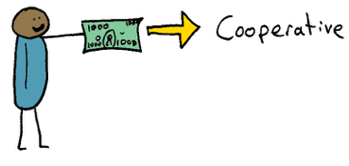
Steps To Becoming a Member:
Work for the Cooperative for at least ____ months and attend ____% of member meetings, unless Members waive these requirements.
Be approved by a vote of ____% of Members.
Pay at least $_______ toward a total capital
contribution of $_______. A new Member can
pay the full amount in ___ monthly payments.
This capital contribution goes in the Member’s Capital Account.
Accept and sign this Agreement.
Important!
Members may not sell or transfer all or any part of their membership interest.
Notes:
-- This page describes the steps to becoming a member (owner) of the cooperative. You might want different requirements for your cooperative, such as requiring that people attend a training before joining.
-- This sample requires that people work for the cooperative for a period of time before they can become an owner. Note that someone must be treated as an employee if they work for the coop before becoming a member, so many coops will want to waive the requirement to work for a year, because many cooperative do not want to have employees.
-- After working for the cooperative for a period of time, then the members vote to approve the new member. Many cooperative require that ALL members approve bringing int a new member. Co-owning a business with someone is an important decision!
-- Number 3 describes the capital contribution. Most cooperatives require that new members make a capital contribution, which is money that the cooperative will use for the business. This is your investment in the cooperative -- it’s money that you put at risk: you may get it back or, if business is not doing so well, the cooperative could lose that money. You’ll see that this agreement gives new members the option to pay their capital contribution in monthly payments.
-- A last step to becoming a member is signing this agreement on the last page.

Slide 6
Los Pasos para Convertirse en un Miembro
Trabajar para la cooperativa por al menos _____ meses y asistir _____% de reuniones de Miembros, a menos que los Miembros renuncien a estos requisitos.
Ser aprobado por un voto de ____% de Miembros.
Pagar al menos $______ de la contribución
de capital total de $_____. Un Miembro nuevo
puede pagar la cantidad total en _______ pagos
mensuales. Esta contribución de capital va en la Cuenta de Capital del Miembro.
4. Aceptar y firmar a este acuerdo.
¡Importante!
Los Miembros no pueden vender ni transferir la totalidad o parte de sus intereses de membresía.

Slide 7

Membership Termination
Voluntary Termination: A Member can leave the
Cooperative voluntarily after giving written notice
at least ______ days in advance.
Involuntary Termination: A Member may be terminated involuntarily if they:
Are voted out by ______% of the other Members; however, a member who has worked for the Cooperative for less than one year may be voted out by ______% of the other Members.
Have not worked for the Cooperative for a period of ______ weeks.
Are determined, by a medical professional, to be mentally incapable of handling their own affairs, or
Are deceased.
Notes:
Now how do you leave the cooperative? First, there is a way to leave voluntarily, by giving written notice some number of days in advance. Second, there are also things that can happen that would cause your membership to terminate involuntarily. For example, the other members might vote you out, or if you stop working for the cooperative for a certain number of weeks, you membership could terminate automatically.

Slide 8
La Terminación de la Membresía
Terminación Voluntaria: Un Miembro puede renunciar a
su membresía en la cooperativa voluntariamente después
de dar una notificación escrita con al menos ______
días de anticipación.
Terminación Involuntaria: Un Miembro puede ser terminado si:
Es expulsado con un voto de los Miembros de ____%; sin embargo, un Miembro que haya trabajado para la cooperativa por menos de un año puede ser expulsado con un voto de los Miembros de ____%.
No ha trabajado para la cooperativa por un período de ____ semanas.
Un profesional médico considera que el Miembro está mentalmente incapacitado para manejar sus propios asuntos.
Han fallecido.

Slide 9
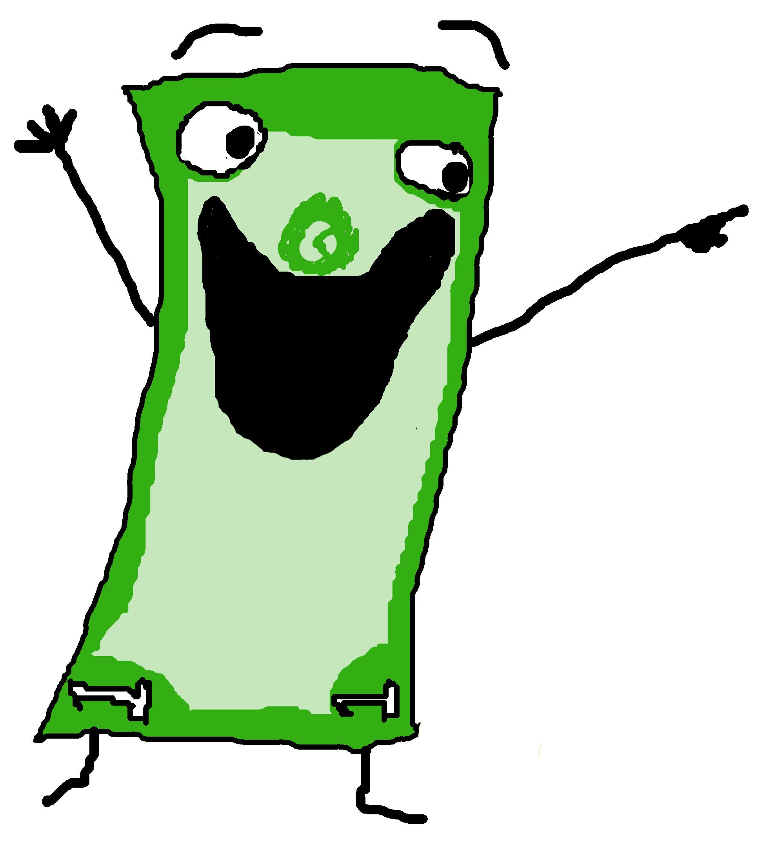
Payments and Rights upon Membership Termination
Payment of Capital Account: When a Member terminates their membership, voluntarily or involuntarily, the amount in Member’s Capital Account becomes a loan from the Member to the Cooperative at ______% interest. The Cooperative must repay the loan within ______ years. If the Member dies or cannot receive the payment, then the Cooperative will pay any beneficiary designated by the Member.
No Other Rights: The terminated Member shall have no other rights to distribution or payment from the Cooperative, nor any rights of membership.
Notes:
This page describes what money and rights a member gets when they leave. For example, this says that the cooperative will pay the member the money in their capital account. In many cooperatives, that tends to be just a few thousand dollars -- it’s the money the member put into the cooperative when they joined, plus any profits that have been allocated to them and not yet paid, and possibly subtracting any losses. This also says that the cooperative doesn’t have to pay them all of the money at once, but can pay it over time.

Slide 10
Pagos y Derechos al Finalizar la Membresía
Pago de Cuenta de Capital: Cuando un Miembro termina su membresía, voluntaria o involuntariamente, la cantidad en la Cuenta de Capital del Miembro se convierte en un préstamo del Miembro hacia la Cooperativa con ______% de interés. La Cooperativa debe devolver el préstamo dentro de ______ años. Si el Miembro fallece o no puede recibir el pago, entonces la Cooperativa debe pagar al beneficiario designado por el Miembro.
Ningún Otro Derecho: El Miembro terminado no tendrá otros derechos de distribución o pago de la Cooperativa, ni ningún derecho de membresía.

Slide 11

Management
Every Member is a Manager: The Cooperative is
managed by all the Members.
Every Member May Sign for the Cooperative: All
Members are agents of the Cooperative and have the
authority to enter into contracts on behalf of the Cooperative.
Members are not Employees: All Members shall participate in the profits, losses, and management of the Cooperative as co-owners and co-managers, and therefore no Member is an employee of the Cooperative.
Dividing Management Among Committees: The Members may delegate the management of certain work to committees of Members, but any major decision substantially affecting the business, Members, or finances must be made by all Members, not by committees.
Notes:
This page deals with management and governance of a cooperative. A very important point is being made in this operating agreement, which is that every member is a manager. There is not one boss telling the workers what to do -- everyone is involved in determining major business decisions, hiring, policy, strategy, and operational processes for the cooperative. Everyone can sign documents on behalf of the cooperative. And because this is an LLC and every member takes part in the profits, losses, and management of the business, it also means that the members are not employees. They are owners, not employees. The final paragraph here says that the cooperative may divide up management into multiple committees -- this is helpful especially when you have more than a few members. You might have a financial committee, a conflict resolution committee, and so on. But this also says that important decisions about the business still need to be made by all members.
Sara’s feedback: I’d recommend being a little more specific about what constitutes a “major decision substantially affecting the business, Members, or finances” that can’t be delegated to committees. Just so the coop makes sure that all members have a voice in the types of decisions that, if delegated, might create an employer-employee relationship. This could also go in a separate polices doc, but I’d just want to make sure the members understand that they can’t create a governing committee or board or that kind of thing.

Slide 12
La Gestión
Cada Miembro es un Administrador: La Cooperativa es
gestionada por todos los Miembros.
Cada Miembro Puede Firmar a Nombre de la Cooperativa:
Todos los Miembros son agentes de la Cooperativa y tienen la
autoridad a entrar en contratos en nombre de la Cooperativa.
Los Miembros no son Empleados: Todos los Miembros participarán en las ganancias, pérdidas y administración de la Cooperativa como co-propietarios y co-administradores y, por lo tanto, ningún Miembro es un empleado de la Cooperativa.
Dividir la Gestión entre los Comités: Los Miembros pueden delegar la gestión de ciertas tareas a los Comités de Miembros, pero cualquier decisión importante que afecte sustancialmente al negocio, sus Miembros o a las finanzas debe ser hecha por todos los Miembros, no por los Comités.

Slide 13

Meetings, Proposals, and Voting
Every Member Has One Vote. Equal voting power is a core
principle of cooperatives, so every Member has an equal vote.
Bringing Proposals: Any Member may bring a Proposal to all Members. Proposals include requests to change policy, to start a new project, to change ways of working, or to change the roles and positions of Members.
Passing Proposals: Decisions by Members will be passed with ______% approval of all Members, unless this Agreement or another policy requires a different voting threshold.
Meetings and Virtual Decisions: Decisions may be made at meetings (in-person or virtual) or in writing (by email, text, or another communication platform). Any two Members may call a meeting of all Members. All Members will be notified of a meeting at least ______ days in advance, unless all Members agree that less notice is ok for that meeting. All Members must meet together at least twice per year.
Notes:
This page goes into more detail about meetings, proposals, and voting. First, it makes clear that everyone has an equal vote. And not only can everyone vote, but anyone can bring a proposal to be voted on. Proposals are the things that shape the business and steer its direction. You might bring a proposal to adopt a new policy, to change work schedules, or to change the work that specific people do in the cooperative. The third paragraph here says how that proposal passes: do you want 100% of members to approve it? 75%? Many agreements go into even more detail about this, but we have kept this one simple. The last paragraph deals with meetings: how often do you meet? Who can call a meeting? How much advance notice to members need to get before a meeting?

Slide 14
Reuniones, Propuestas y Votos
Cada Miembro tiene un voto. La igualdad de poder de decisión es un
principio básico de las cooperativas, por lo que cada Miembro tiene igualdad de voto.
Presentación de propuestas: Cualquier Miembro puede presentar una propuesta a todos los Miembros. Las propuestas incluyen solicitudes para cambiar una política de la cooperativa, iniciar un nuevo proyecto, cambiar las formas de trabajar o cambiar los roles y las posiciones de los Miembros.
Aprobación de propuestas: Las decisiones de los Miembros se tomarán con ______% de aprobación de todos los Miembros, a menos que este Acuerdo u otra política requiera un porcentaje de aprobación diferente.
Reuniones y decisiones virtuales: Las decisiones se pueden tomar en reuniones (en persona o virtuales) o por escrito (por correo electrónico, texto u otra plataforma de comunicación). Dos Miembros pueden convocar una reunión de todos los Miembros. Todos los Miembros serán notificados de una reunión con al menos ______ días de anticipación, a menos que todos los Miembros acuerden que una notificación de menor plazo es aceptable para esa reunión. Todos los Miembros deben reunirse al menos dos veces al año.

Slide 15

Keeping Records and Information
The Cooperative shall keep and make the following information and records available to all Members:
A signed copy of this Operating Agreement and any amendments,
Bookkeeping records for all years,
The LLC tax returns for all years,
Financial statements for all years,
Notes on decisions made in meetings; and
A list of Members, past and present, their contact information, and any designated beneficiaries.
Notes:
Finally, this page has a list of information and documents that the cooperative is obligated to keep and make available to all members. This is so that everyone has the opportunity to understand the business, its finances, and its decisions, so that everyone can be an informed owner and manager of the business.

Slide 16
Manteniendo Registros e Información
La Cooperativa mantendrá y hará que la siguiente información y registros estén disponibles para todos los Miembros:
Una copia firmada de este Acuerdo de Operaciones y sus modificaciones,
Registros contables de todos los años,
Las declaraciones de impuestos de la LLC de todos los años,
Estados financieros de todos los años,
Notas sobre decisiones tomadas en reuniones, y
Una lista de Miembros, pasados y presentes, su información de contacto, y los beneficiarios designados.

Slide 17
Regular Compensation to Members and Founders
Regular Pay for all Members: The Members will decide a rate of regular pay for each Member. This regular pay is also called “Guaranteed Payments,” and it can be an hourly, weekly, monthly, or per-job amount that each Member will receive for their work. The Members will decide how often to make Guaranteed Payments.
Profit Accounting: At the end of every _____________ (monthly/quarterly/yearly) period, Members will calculate profits. Profits are earnings from the period that remain after payment of all business expenses and guaranteed payments.
Founders’ Bonuses: The Founders of Cooperative are _____________________ _________________________ (names). To compensate Founders for their risk and many hours of unpaid work, the Cooperative will pay each Founder a $_________________ bonus. This bonus will be paid gradually using 20% of profits from each period.
Notes:
These next few pages deal with the finances of the cooperative and how members get paid. There are a few ways that members get paid:
First, the cooperative can make regular payments to people for the work that they do. You might decide, for example, that everyone will get paid at least $15 per hour. In LLCs, this is called “guaranteed payments,” because the idea is that you can rely on this as your regular income.
Next, members share the profits of the business. You might decide that at the end of every month, every quarter, or every year, you will do a calculation of the profits of the business, meaning how much money is leftover from your earnings after you have paid your business expenses. This sample agreement says that 20% of those profits will be paid to the founders of the business until it reaches a certain amount. That is an amount that the cooperative has decided to compensate founders for the risk that they took and the many unpaid hours they worked to get the business started. I have seen cooperatives set this amount at anywhere from $1,000 to $50,000. It’s whatever feels fair.

Slide 18
Compensación Regular a Miembros y Fundadores
Pago Regular para todos los Miembros: Los Miembros decidirán una tasa de pago regular para cada Miembro. Este pago regular también se llama “Pagos Garantizados,” y puede ser por hora, semanal, mensual, o por la cantidad de tareas que cada Miembro recibirá por su trabajo. Los Miembros decidirán con qué frecuencia realizar estos pagos garantizados.
Contabilidad de Ganancias: Al final de cada periodo ____________ (mensual/trimestral/anual), los Miembros calcularán las ganancias. Las ganancias son ingresos de este período que quedan después del pago de todos los gastos del negocio y los pagos garantizados.
Primas para los Fundadores: Los Fundadores de la Cooperativa son _____________________________________________ (nombres). Para compensar a los fundadores por su riesgo y muchas horas de trabajo no remunerado, la Cooperativa le pagará a cada fundador una prima de $____________. Esta prima se pagará gradualmente usando el 20% de las ganancias de cada período.

Slide 19

Sharing Profits
Allocating Profits to Member Capital Accounts: At the end of every _____________ (monthly/quarterly/yearly) period, after paying Founders Bonuses, all other profits will be allocated to Members’ Capital Accounts on the basis of Patronage. Unlike in a conventional business, where some owners get more profits based on their ownership share or percentage interest, the Cooperative divides profits among Members on the basis of the value or quantity of each Members’ work, also known as “Patronage.” Patronage is measured based on [choose one]:
⬜ The number of hours each Member works,
⬜ The value of client invoices generated by each Member’s work, or
⬜ The amount each Member receives in Guaranteed Payments.
Distributing Profits to Members: At least every quarter, Members shall distribute cash to Members from the Members’ Capital Accounts. The Cooperative shall distribute, at minimum, sufficient cash to cover Member tax obligations. However, the Cooperative shall not make distributions if doing so would leave the Cooperative unable to pay its obligations and liabilities.
Notes:
This page says what happens with the rest of the profits. Cooperatives are unique because they generally divide profits based on members’ “patronage” -- meaning the amount of work or the value of work that members do. This is different than most conventional businesses, where some people get more profits just because they own more of the business. Most cooperatives that I know divide profits based on the number of hours that each Member works, meaning that the person who worked the most hours will also get a larger share of the profits. This sample agreement gives you other options to choose from, and you might choose a different method of dividing profits, depending on the type of business you have.
Note that there are two paragraphs here: one that says how you allocate the profits to each member, and the other that says when you distribute the profits. This is because the cooperative might have profits that it assigns to each member, but the cooperative might decide to keep the money in the cooperative’s accounts because you need that money to keep operating the business.

Slide 20
Compartir Ganancias
Asignación de Ganancias a las Cuentas de Capital de los Miembros: Al final de cada período _____________ (mensual/trimestral/anual), después de pagar las Primas a los Fundadores, todas las demás ganancias se asignarán a las Cuentas de Capital de los Miembros sobre la base del patrocinio. A diferencia de un negocio convencional, donde algunos propietarios obtienen más ganancias a causa de su participación o interés porcentual, la Cooperativa divide las ganancias entre los Miembros sobre la base del valor o la cantidad del trabajo de cada Miembro, también conocido como "Patrocinio." El patrocinio es medido según [elija uno]:
⬜ La cantidad de horas que cada Miembro trabaja,
⬜ El valor de las facturas de clientes generadas por el trabajo de cada Miembro, o
⬜ El monto que cada Miembro recibe en Pagos Garantizados.
Distribución de ganancias a los Miembros: Al menos cada trimestre, la Cooperativa distribuirá efectivo a los Miembros de sus Cuentas de Capital. La Cooperativa distribuirá, como mínimo, efectivo suficiente para cubrir las obligaciones de impuestos de los Miembros. Sin embargo, la Cooperativa no hará distribuciones si al hacerlo dejará a la Cooperativa incapaz de poder pagar sus obligaciones y responsabilidades.

Slide 21
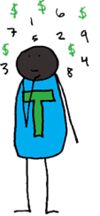
Sharing Losses
If the Cooperative has losses during an accounting period, losses are allocated to each Members’ Capital Account, and Members will share those losses equally. Losses are neither allocated in proportion to Patronage nor in proportion to percentage interest in the Cooperative.
If losses reduce Capital Accounts to zero:
In no event shall net loss be allocated to any such Member if such allocation would reduce such Member’s Capital Account balance to less than zero at the end of the year. See Treasury Regulation §1.704–1(b)(2)(ii)(d)(4)–(6) for more information about negative capital account balances.
Notes:
Of course, you may not always have profits. This page deals with losses and how you share those among members.

Slide 22
Compartiendo Pérdidas
Si la Cooperativa tiene pérdidas durante un período de contable, dichas pérdidas serán asignadas a la Cuenta de Capital de cada Miembro, y los Miembros compartirán las pérdidas equitativamente. Las Pérdidas no son ni asignadas en proporción a patrocinio ni en proporción al porcentaje de interés en la Cooperativa.
Si las Pérdidas reducen las Cuentas de Capital a cero:
En ningún caso, se asignará la pérdida neta a ningún Miembro si dicha asignación redujera el saldo de su Cuenta de Capital a menos de cero al final del año. Ver Regulación de Tesorería §1.704–1(b)(2)(ii)(d)(4)–(6) para más información sobre saldos negativos de la cuenta de capital.

Slide 23

Accounting and Tax
Every Member will have an accounting called the “Capital Account,” which represent the value of the Member’s share of the Cooperative’s assets. Capital Accounts contain a Members’ capital contributions, increased by profit allocations, and decreased by distributions and losses.
(Capital accounts will be maintained in accordance with the capital accounting rules of section 1.704(b)(2)(iv) of the Treasury Regulations.)
The Cooperative shall be taxed as a partnership, unless Members change this.
Additional tax matters: Except as otherwise provided in this Agreement, all items of Cooperative income, gain, loss, deduction and any other allocations not otherwise provided for shall be divided among the Members in the same proportions that they share profit or loss, as the case may be.
The Members shall, individually, pay taxes on their share of business income, including quarterly self-employment tax.
Within 90 days after the end of each taxable year, the Cooperative shall send to each Member (1) the information necessary to complete individual tax returns, and (2) a copy of the Cooperative’s federal, state, and local income tax returns.
Notes:
And this page has more information about accounting and tax. We use small print in some places, especially for information that is more important for your accountant to read. One thing to note here is that every member will need to pay taxes on their share of the business income, and that will likely mean paying taxes on a quarterly basis.

Slide 24
Contabilidad e Impuestos
Se llevará una contabilidad para cada Miembro llamada “Cuenta de Capital,” que representa el valor de la participación del Miembro en los activos de la Cooperativa. Las Cuentas de Capital contienen contribuciones de capital, aumentos por asignaciones de ganancias, y disminuciones por distribuciones y asignaciones de pérdidas.
(Las cuentas de capital se mantendrán conforme a las reglas de contabilidad de capital de la sección 1.704(b)(2)(iv) de los Regulaciones de Tesorería.)
La Cooperativa tendrá la categoría de impuesto de sociedad, a menos que los Miembros cambien esto. Asuntos fiscales adicionales: Salvo que se estipule lo contrario en este Acuerdo, todas las partidas de ingresos, ganancias, pérdidas, deducciones y otras asignaciones de la Cooperativa que no se estipulen de otra forma se dividirán entre los Miembros en las mismas proporciones que comparten la ganancia o pérdida, según sea el caso.
Los Miembros deberán pagar impuestos individualmente sobre su parte de los ingresos del negocio, incluyendo el impuesto trimestral
Dentro de los 90 días después del final de cada año fiscal, la Cooperativa deberá entregar a cada Miembro (1) la información necesaria para que puedan realizar sus declaraciones de impuestos individuales, y (2) una copia de las declaraciones de impuestos federales, estatales, y locales de la Cooperativa.

Slide 25
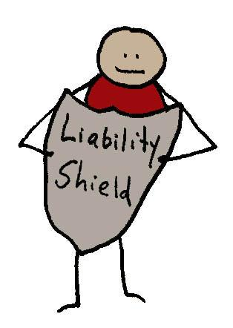
Defending and Compensating Members
The Company shall compensate a Member for any expenses from lawsuits, penalties, fines, and costs of defense if the Member incurred these expenses as a result of being a Member. This is also called “indemnification.” However, the Company may not compensate or “indemnify” a Member if such expenses arose from a situation where the Member stole funds, knowingly received funds to which the Member was not entitled, intentionally committed a crime, or intentionally harmed the Company or Members.
Notes:
This page explains that the cooperative will cover costs or will reimburse members if the member has expenses from a lawsuit related to the business, for example.

Slide 26
Defender y Compensar a los Miembros
La Compañía compensará a un Miembro por cualquier gasto derivado de demandas, sanciones, multas, y costos de defensa si el Miembro incurrió en estos gastos resultado de ser un Miembro de la Cooperativa. Esto también se llama “indemnización.” Sin embargo, la Cooperativa no puede compensar o "indemnizar" a un Miembro si dichos gastos surgieron de una situación en la que el Miembro robó fondos, estando en conocimiento recibió fondos a los que el Miembro no tenía derecho, cometió un delito deliberadamente o perjudicó intencionalmente a la Cooperativa o a sus Miembros.

Slide 27
Closing the Cooperative
The Cooperative can be sold, dissolved, or reorganized with [choose one]:
⬜ the unanimous consent of all Members, or
⬜ the consent of 75% of the Members.
If the Cooperative is sold, dissolved, or liquidated, the Cooperative will liquidate the assets and allocate any net profit, net loss, and other items of income, gain, loss or deduction to the Members’ Capital Accounts on the same basis that profits and losses are allocated according to this agreement. The Cooperative will then make payments in the following priority order:
First, the Cooperative must pay off its debts to non-Members.
Second, the Cooperative must pay its debts to Members.
Third, the Cooperative must pay each Member’s Capital Account balance to each current Member.
Notes:
And this page explains how to close the cooperative -- to either dissolve it or sell the business. What percentage of members must approve closure of the cooperative, and what happens with the cooperative’s assets or sale proceeds.

Slide 28
Cerrando la Cooperativa
La Cooperativa puede ser vendida, disuelta, o reorganizada con [eligir uno]:
⬜ el consentimiento unánime de los Miembros, o
⬜ el consentimiento de 75% de los Miembros.
Si la Cooperativa se vende, disuelve o liquida, la Cooperativa liquidará los activos y asignará cualquier ganancia neta, pérdida neta, y otras partidas de ingresos, ganancias, pérdidas, o deducciones a las Cuentas de Capital de los Miembros sobre la misma base que las ganancias y pérdidas se asignan conforme a este acuerdo. La Cooperativa hará pagos en el siguiente orden de prioridad:
Primero, la Cooperativa debe pagar sus deudas a los no Miembros.
Segundo, la Cooperativa debe pagar sus deudas a los Miembros.
Tercero, la Cooperativa debe pagar el saldo de la Cuenta de Capital de cada Miembro a cada Miembro actual.

Slide 29

Acceptance of Agreement
By signing below, the Members agree to all of the terms and conditions in this Agreement.
Date: _______________________ SIGNATURE:_______________________
NAME:____________________________
Date: _______________________ SIGNATURE:_______________________
NAME:____________________________
Date: _______________________ SIGNATURE:_______________________
NAME:____________________________
Date: _______________________ SIGNATURE:_______________________
NAME:____________________________
Notes:
And here’s the page where everyone signs to make this the official operating agreement of the LLC.

Slide 30
Aceptar al Acuerdo
Al firmar a continuación, los Miembros aceptan todos los términos y condiciones de este Acuerdo.
FECHA: _______________________ FIRMA:___________________________
NOMBRE:_________________________
FECHA: _______________________ FIRMA:___________________________
NOMBRE:_________________________
FECHA: _______________________ FIRMA:___________________________
NOMBRE:_________________________
FECHA: _______________________ FIRMA:___________________________
NOMBRE:_________________________

